Slide 1
Pages and Navigation
Creating an Effective User Interface
Notes:
In this module you will learn how to create custom application pages as well as content pages and the details around customizing pages. In addition this module will also dive into the aspects of customizing the SharePoint user interface for custom branding experiences as well as customizing and extending the SharePoint Ribbon.

Slide 2
Agenda
Master Pages
Application Pages
Site Pages
Extending the Ribbon

Slide 3
Standards Support
SharePoint 2010 Browser Support
Internet Explorer 7 & greater
FireFox 3.5 & greater
Apple Safari 4.0 & greater
Google Chrome (added with SharePoint 2010 SP1)
Accessibility
Conforms to WCAG 2.0 AA standards
Conforms to United States Federal Government Section 508c of the 1973 Disabilities Act

Slide 4
A SharePoint Site is a Collection of Pages
All pages share the same look and feel
HTML page layout defined by common Master Page
Page formatting defined by common CSS files
Client-side behaviors defined by JavaScript files
Pages within site can be split into two categories
Site Pages exist within the content DB for a site
Application Pages only exist on file system of WFE
Notes:
All pages within a SharePoint site have the same look and feel. The pages are based on a common Master page and implement the same CSS files.
Site pages live within a content database and can be customized by the user.
Application pages live on the file system and cannot be customized by the user.

Slide 5
Site Pages versus Application Pages
Site Pages exist within virtual file system of site
They support customization via Web Parts and/or SPD
They may be customized / uncustomized
Ghosted / Unghosted
Customized pages impact performance and security
Application Pages are deployed once per farm
They are accessible through _layouts virtual directory
They are parsed / compiled in classic ASP.NET mode
They do not support Web Part personlization or customization
Notes:
Site pages:
By default site pages are ghosted, which means that the page template is stored on the WFE file system, while the content is stored in the content database.
Site pages can be customized. At that time they become unghosted and both the template and the content are stored in the content database.
This can seriously impact the performance.
Application pages:
Are deployed in the _layouts folder of the SharePoint root on the file system.
There is one version of an application page scoped at the farm level.
It is compiled into a single DLL and loaded into memory once for each Web application.

Slide 6
SharePoint Integration with Master Pages
Master Page integration with SharePoint 2007
Master Pages stored in Master Page Gallery (MPG)
MPG created automatically on per site basis
Site pages link to default.master in MPG
Application pages link to *.master files in _layouts
Changes in SharePoint 2010
default.master serves as master page for v3 UI
v4.master serves as default master page for new v4 UI
Site pages and Application pages link to v4.master
minimal.master provided OOTB
Notes:
In SharePoint 2007:
When a site is created, a Master Page Gallery is created and SharePoint provisions an instance of the default.master within the site.
Application pages link to a master page in the _layouts folder, f.e. the application.master.
In SharePoint 2010
Default.master is still there for backward compatibility.
New site pages created in SharePoint 2010 link to the v4.master.
Also application pages link to the v4.master.
A minimal.master is provided out of the box, which wasn’t the case in SharePoint 2007.

Slide 7
Understanding v4.master
By default, all pages in site link to v4.master
v4.master links to CSS files including corev4.css
v4.master links to rich client-side library of *.js files
What developers need to know about v4.master
General HMTL layout of important <div> elements
Named placeholders and their locations
How to extend corev4.css with additional formatting
How to add JavaScript and leverage out-of-box APIs
Notes:
The v4.master:
The default team site master page in SharePoint 2010 and links to the corev4.css file for its layout.
SharePoint 2010 comes with a rich client-side javascript library, to which v4.master links.
As SharePoint 2010 now heavily relies on the ribbon, the v4.master also includes the Ribbon.
The HTML layout is based on <div> elements.

Slide 8
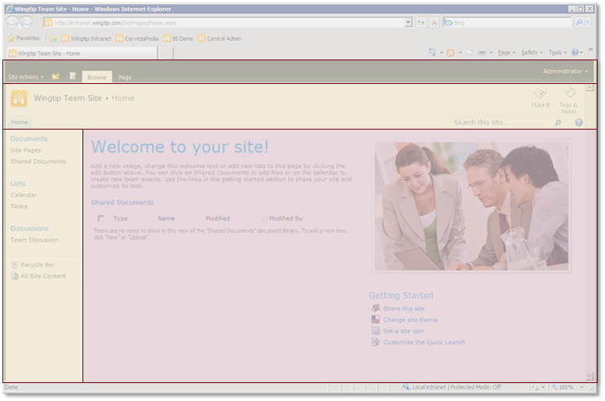
Named <div> tags in v4.master
<div id="s4-ribbonrow">
<div id="s4-titlerow">
<div id="MSO_ContentTable">
<div id="s4-leftpanel">
Notes:
The most important <div> tags in v4.master are:
s4-ribbonrow: this is the container for the server ribbon and the site actions menu.
s4-titlerow:this is the container for the title, tags and main navigation.
s4-leftpanel: this is the container for the left navigation and displays the Quick Launch.
mso-cententtable: this is the container for the content of the page instance.

Slide 9
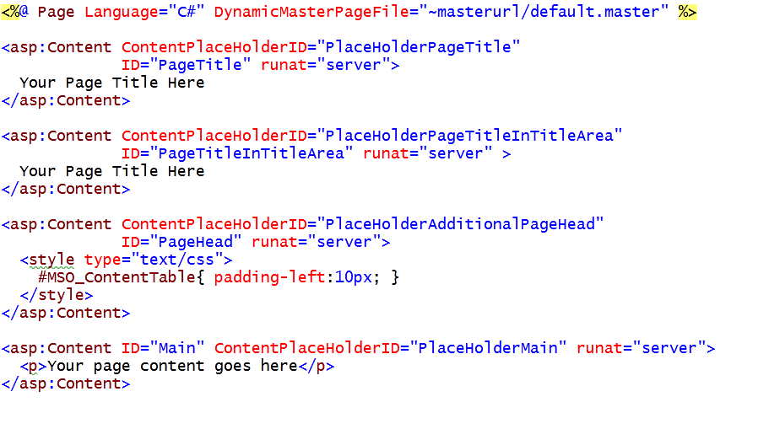
Overriding PlaceHolders in v4.master
Notes:
In your pages you can override the PlaceHolders of v4.master and replace them with your own content.

Slide 10
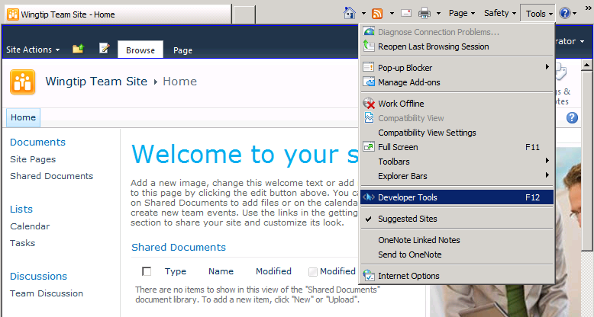
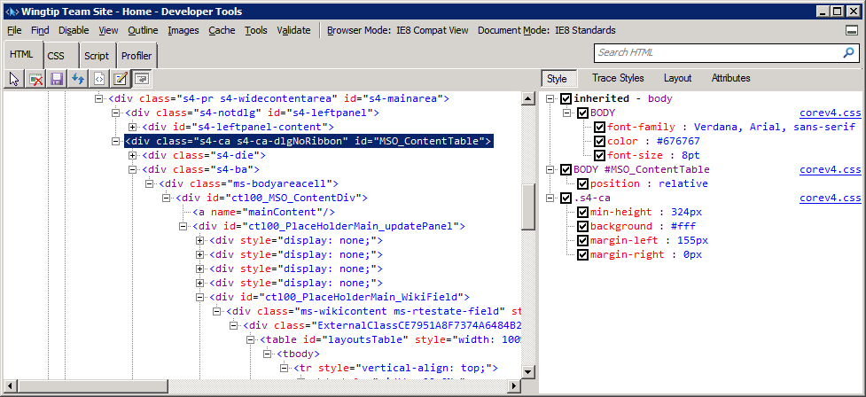
Using the IE8 Developer Tools
Very useful utility
Inspect HTML and CSS classes
Debug JavaScript on page
Notes:
Internet Explorer Developer Tools integrate with Internet Explorer and are easy to use. They provide a visual interface to help you inspect and debug HTML and CSS classes, and you can debug JavaScript. The debugger can be started and stopped, and they allow on-the-fly editing of the sources. Changes to the code can be saved.

Slide 11
DEMO
Working with Master Pages in the WingtipUI Solution Demo

Slide 12
Agenda
Master Pages
Application Pages
Site Pages
Extending the Ribbon

Slide 13
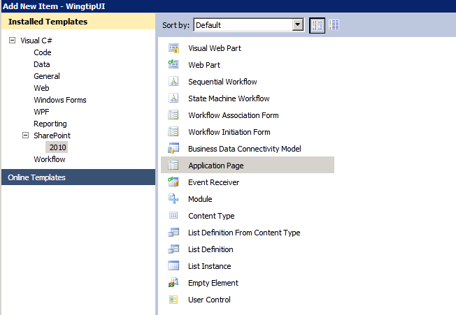
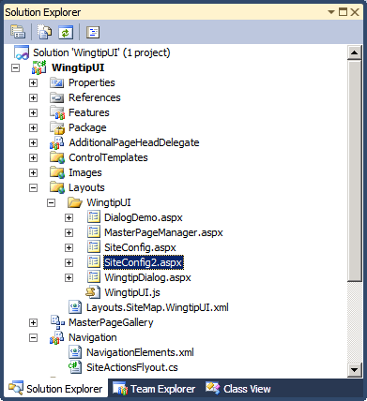
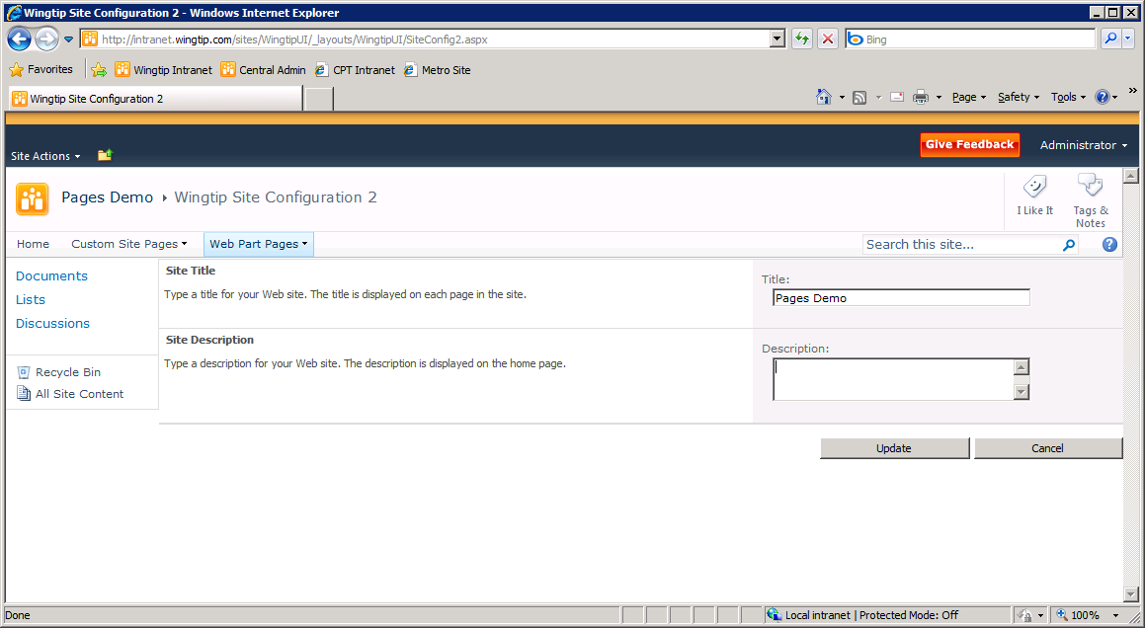
Creating Application Pages
Creating a Custom Application Page
Create new SharePoint Project using SPTools
Create new SPI from Application Page template
Override PlaceholderMain to add HTML and controls
Create event handlers to handle page lifecycle events
Override other specific placeholders as needed
Notes:
Using Visual Studio 2010 Tools for SharePoint, you can create custom application pages:
Create a project using the Visual Studio 2010 SharePoint Tools.
Add a new Application Page project item.
Override the PlaceholderMain to add your own HTML, ASP.NET controls and SharePoint controls.

Slide 14
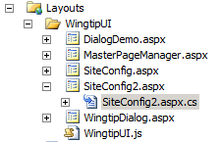
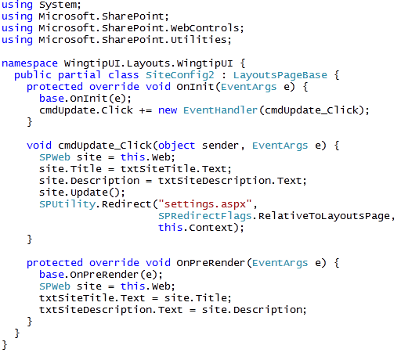
Adding Code to An Application Page
Notes:
You can also add code to custom application pages:
Create a class that inherits from LayoutsPageBase, which resides in the Microsoft.SharePoint.WebControls namespace of the Microsoft.SharePoint.dll
In the .aspx page, add a directive that specifies that the page inherits from your custom class. <@Page Language=“C#” MasterPageFile=“~masterurl/default.master” Inherits=”WingtipUI.Layouts.WingtipUI.SiteConfig2” >
Implement the functionality and handle events that are fired by the controls on the application page

Slide 15
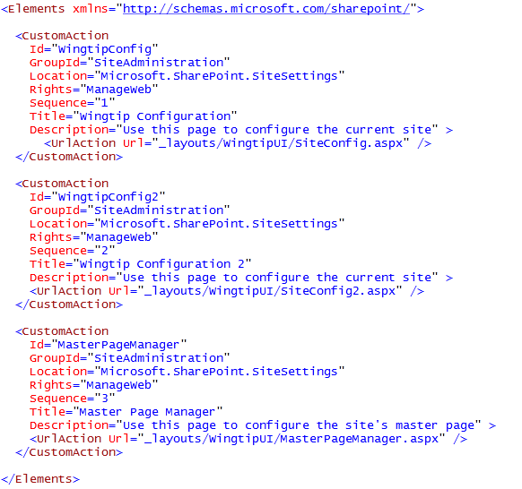
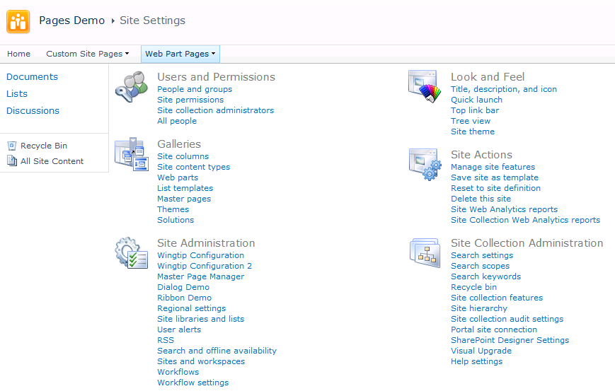
Navigating with CustomActions
CustomAction elements provide navigation
Add links to Site Settings page
Add menu items to Site Action menu or Item ECB menu
Notes:
To be able to navigate to the custom application page, add a CustomAction element. CustomActions can be used to add links to the Site Settings, page, to the Site Actions menu, to toolbars, to the Edit Control Block, and so on.

Slide 16
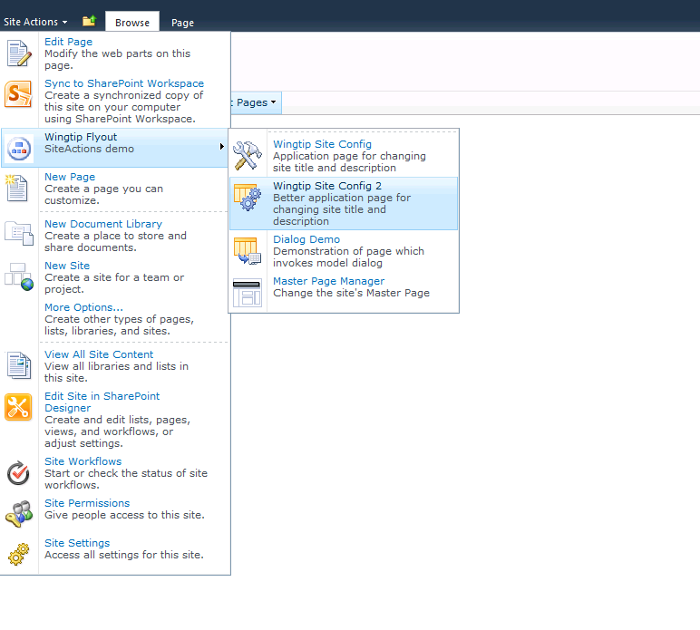
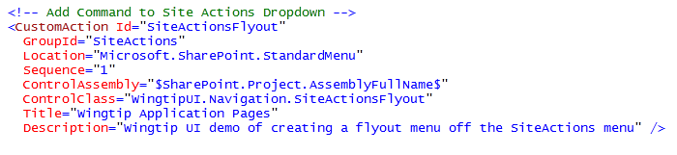
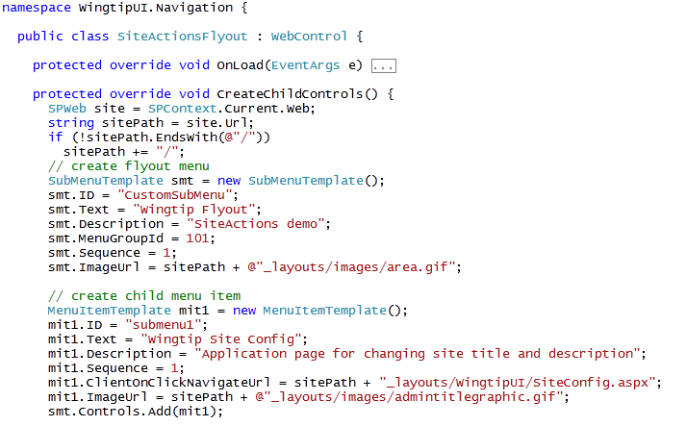
Creating a SiteActions Flyout Menus
Notes:
You can also create a SiteActions flyout menu. This is a WebControl that adds SubMenuTemplate instance to x. You can add one or more menuItemTemplate instances to the SubMenuTemplate instance to make up your flyout menu.
Your flyout menu is added to the Site Actions menu by defining a CustomAction that sets the following attributes:
GroupId to SiteActions.
Location to Microsoft.SharePoint.StandardMenu.
ControlAssembly to the full qualified name of the assembly where you created your flyout menu.
ControlClass to the name of the class that creates your flyout menu.

Slide 17
DEMO
Inspecting Custom Application Pages
in the WingtipUI Solution Demo

Slide 18
Agenda
Master Pages
Application Pages
Site Pages
Extending the Ribbon

Slide 19
Site Pages and Safe Mode Processing
Site pages can be customized using SPD
Uncustomized pages are ghosted
Customized pages are unghosted
Customized site pages run in Safe Mode
They do not support inline code
They only support controls registered as Safe Controls
Notes:
Uncustomized pages are called ghosted pages. Only the difference between the page and the template is stored in the content database. Customized pages are stored completely in the content database and are called unghosted pages.
Site pages can be customized using SharePoint Designer.
Customized site pages don’t support inline code. You can only add controls that are registered as Safe Controls in the web.config.

Slide 20
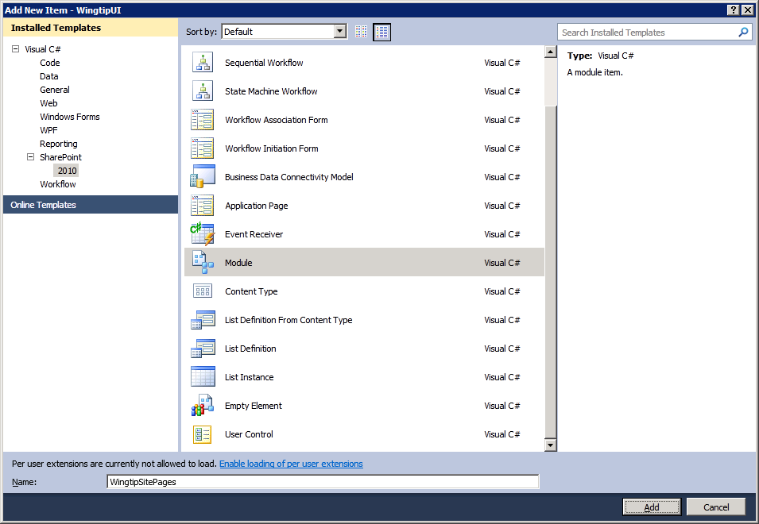
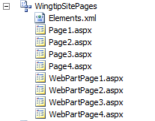
Creating Site Pages from Page Templates
Site Page Instances created from page template
Page template files must be deployed using feature
Provision using <Module> element with <File> element
Supported by SharePoint using Module SPI
Notes:
You can create site pages using the Visual Studio 2010 Tools for SharePoint. The SPI template to use is Module. The elements.xml is the manifest that specifies a <Module> element, which in turn contains a set of <File> elements . Each <File> element provisions one instance of a page from the custom page template you created in the project.

Slide 21
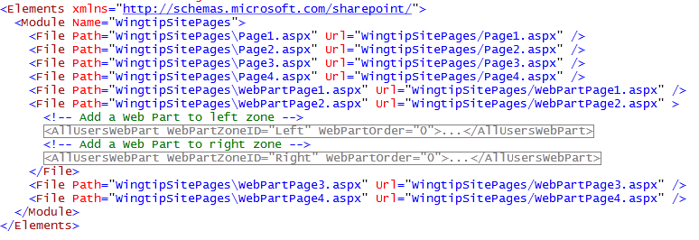
Module SPI and the elements.xml File
Module SPI updates element.xml for you
You just create / add files to SPI folder
Some scenarios requires manual edits to elements.xml
Notes:
With the Visual Studio 2010 Tools for SharePoint you only have to create the Module SPI and add the site pages. The element.xml will be generated automatically by the tools.

Slide 22

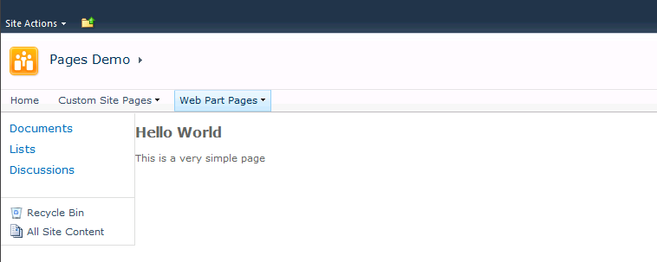
'Hello World' Page Template for Site Page
Notes:
This is a sample of a provisioned site page based on the HelloWorld.aspx page template you created in the Visual Studio project.

Slide 23
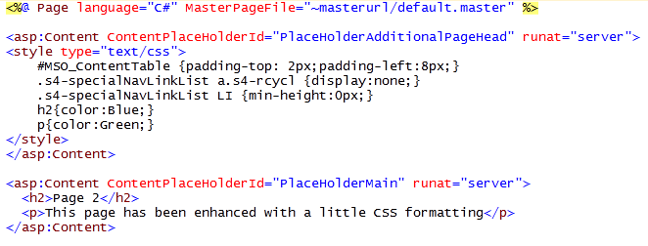
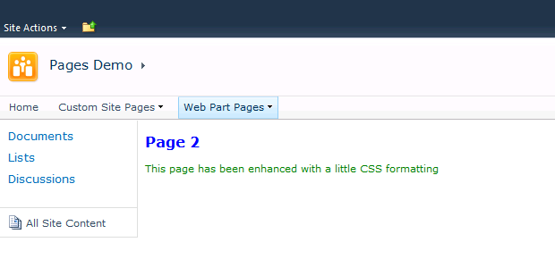
Adding a Little More Style
Notes:
Use the PlaceHolderAdditionalPageHead placehoder to add your own CSSstyles to your site pages. These styles can then be used from within the PlaceHolderMain placeholder.

Slide 24
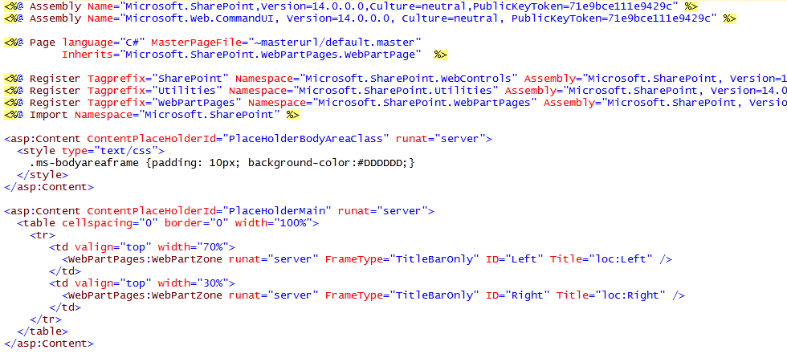
Designing Web Part Pages
Changes from previous page templates
Inherit from Microsoft.SharePoint.WebPartPages.WebPartPage
Add controls for Web Part Zones
Notes:
Web Parts make it possible for a site owner to customize a site page with changes that are seen by all users. Web Parts go even further to allow individual users to add personalization changes that are seen only by them. On top of that, customizing and personalizing Web Parts does not require customizing the Web Part pages that host them.
You can also design Web Part pages as a site page template. In that case the .aspx page inherits from Microsoft.SharePoint.WebPartPages.WebPartPage.
Add WebPartZone controls to the site page template because Web Parts reside in WebPartZones. You have to specify the WebPartZones but not the Web Parts that go inside that zone. Instead, all of the data for tracking Web Part instances and their customization and personalization data are kept in separate tables inside the content database. This means that a Web Part page can remain in a ghosted state, even when users customize them.

Slide 25
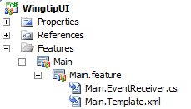
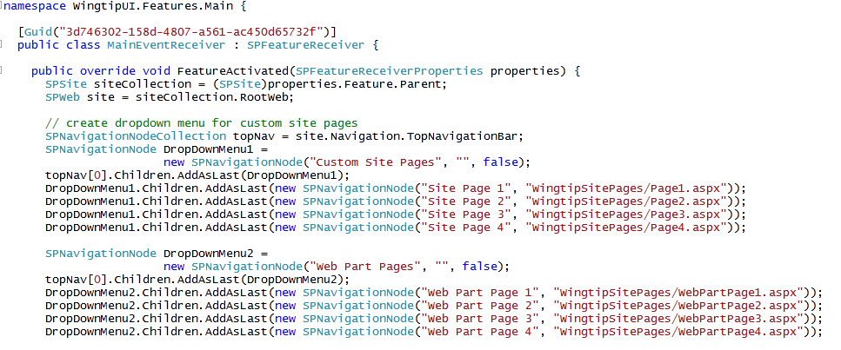
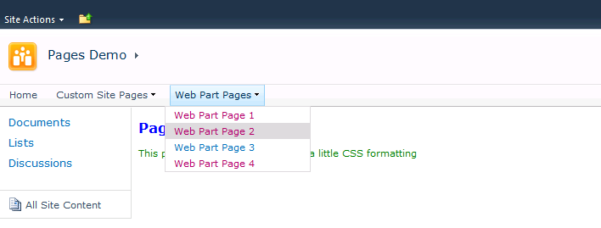
Adding Navigation Nodes to TopNav
Notes:
When your site page instances are created, they must be made accessible to the users. An option is to add navigation nodes to the top navigation bar when the feature containing the site pages gets activated.
In the FeatureActivated event handler of the FeatureReceiver class you can retrieve the top navigation bar from the site using site.Navigation.TopNavigationBar. This returns a collection of type SPNavigationNodeCollection. Write code that adds instances of type SPNavigationNode to that collection.

Slide 26
DEMO
Provisioning Site Pages using Page Templates in the WingtipUI Solution Demo

Slide 27
Agenda
Master Pages
Application Pages
Site Pages
Extending the Ribbon

Slide 28
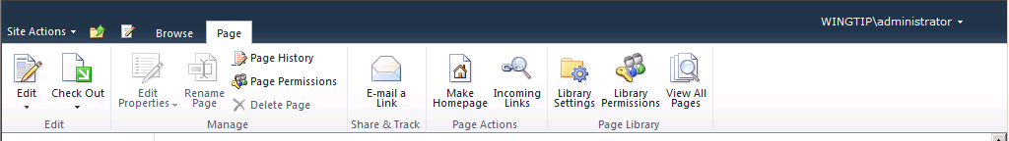
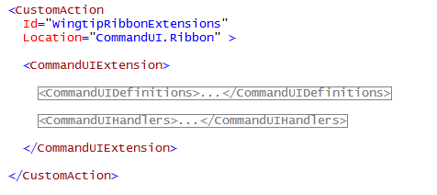
The Server Ribbon
Introduced in SharePoint 2010
Provides familiar place to find & execute commands
Creates parity with ribbon in Office client application
Developers extend Ribbon with <CustomAction>
Notes:
The prime real-estate of SharePoint 2007 has been consolidated into the Ribbon.
Consistency with the client ribbon in style, controls and sense of fluency (automatic resizing for instance).
Streamlined, AJAX enabled, only gets content that is shown.
Familiar, it will be the place to interact with SharePoint for just about any task that end-users need to get done in the product.
The ribbon is extensible with <CustomAction> elements. The ribbon tabs, groups and buttons must be defined in the <CommandUIDefinitions> element. By specifying a Location attribute you can indicate where you want your custom tab, group or button added. The actions that need to be executed by your custom ribbon buttons need to be defined in the <CommandUIHandlers> element.

Slide 29
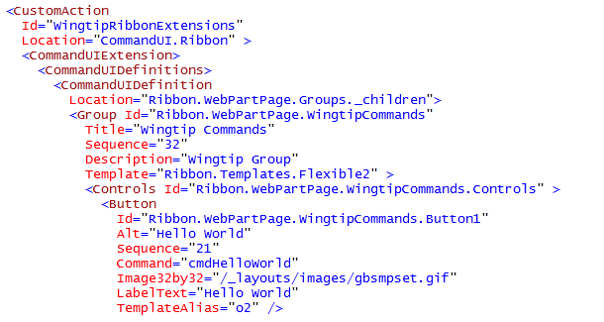
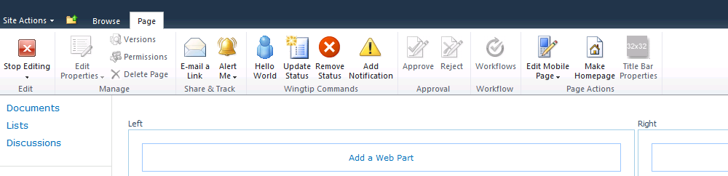
Adding Groups and Controls
<CommandUIDefinition> specifies location attribute
Notes:
The <CommandUIDefinition> element has a Location attribute that you can set. Specifying Ribbon.WebPartPage.Groups._children will indicate that you want to add a custom group to the Page tab of a Web Part page.
Within a group you have to add a <Controls> element and within that element you have to specify your <Button> elements.
The <Button> element lets you specify an Id, a Command, a sequence, a button image, and a label text.

Slide 30
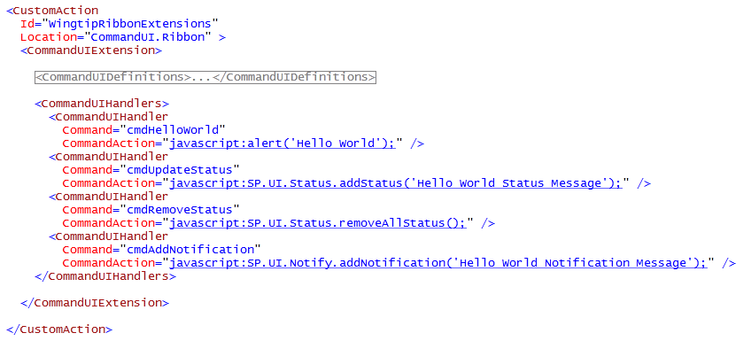
Adding Command Handlers
Two possible approaches
Easy way: add a CommandUIHandlers section
Hard way: create custom page component with JavaScript
Notes:
You define an action for your custom ribbon button by specifying a value for the Command attribute.
There are 2 approaches to link an action to your custom button:
Define a <CommandUIHandler> element that specifies the name of the Command and the javascript to execute.
Create a custom page component with JavaScript that executes the necessary JavaScript and eventually executes calls to the server.

Slide 31
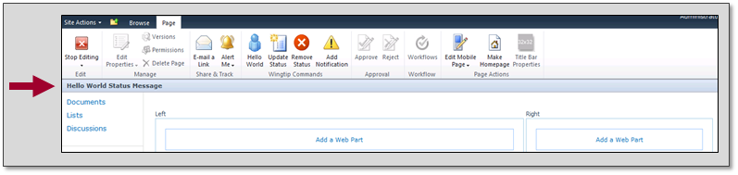
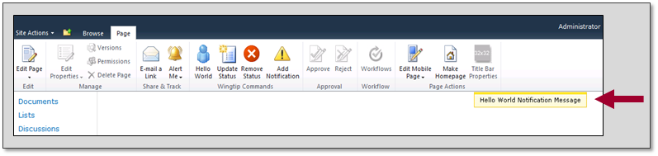
Status Bar and Notification Area
SP.UI.Status.addStatus('Hello World Status Message');
SP.UI.Notify.addNotification('Hello World Notification Message');
Notes:
The Status Bar and Notification Area are two prime places to show messages to the end-user. The status bar can be shown in a few fixed colors that indicate a positive or negative status. The Notification area is used for smaller messages. Of course both items can be accessed through code so you can show your own messages using SharePoint infrastructure.

Slide 32
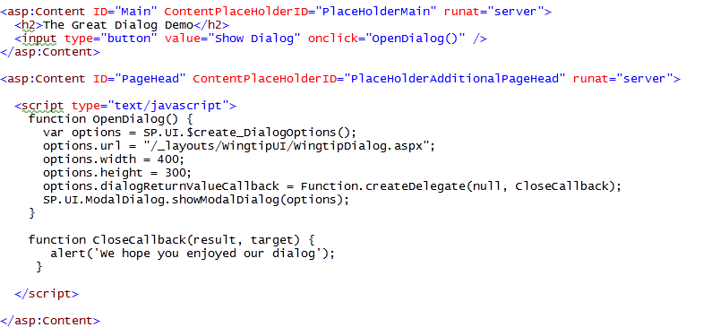
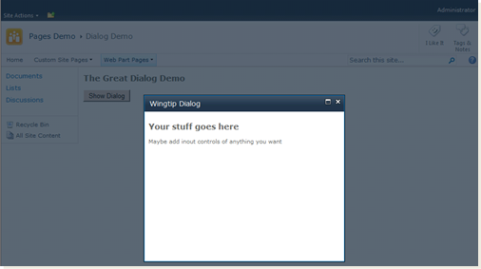
Dialogs
SP.UI.js contains API for creating modal dialogs
Notes:
In SharePoint 2007 whatever you wanted to do, you had to go through one or more pages. If you want to create a new item, you have navigate to the NewForm.aspx page to enter the data. After clicking the Save button you navigate back to the AllItems.aspx page.
One of the major changes in SharePoint 2010 is the display of dialogs to stay in the current context. If you want to create a new item, a dialog opens where you can enter your data. You can still see the AllItems.aspx page through the background. When you click the Save button, the dialog closes and the AllItems.aspx page is refreshed.
You can create your own dialogs by making use of the Dialog framework API that is defined in the SP.UI.js JavaScript file. The dialog itself is a normal SharePoint application page that implements 2 JavaScript methods: OpenDialog and CloseCallback.

Slide 33
DEMO
Inspecting Custom Ribbon Extensions
in the WingtipUI Solution Demo

Slide 34
Summary
Master Pages
Application Pages
Site Pages
Extending the Ribbon

